Slide 1
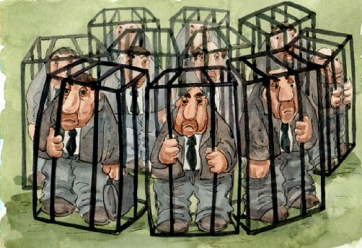
A global perspective on depression Ragnar Asker, Jennifer Bezaire, Rebecca Bond, Kelly Langford

Slide 2
What is Depression?
The World Health Organization (WHO) defines depression as “a common mental disorder that presents with depressed mood, loss of interest or pleasure, feelings of guilt or low self-worth, disturbed sleep or appetite, low energy, and poor concentration” (WHO, 2006).

Slide 3
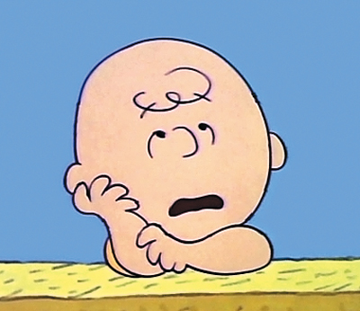
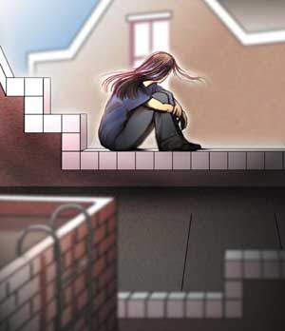
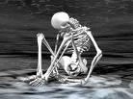
Have A Guess…
Now, depression is the 6th largest burden of disease across the globe, for all ages and sexes.
By 2020…???

Slide 4
OUR FOCUS:
DEVELOPED
Australia, Sweden
& Canada
v.s.
DEVELOPING
India & Uganda

Slide 5
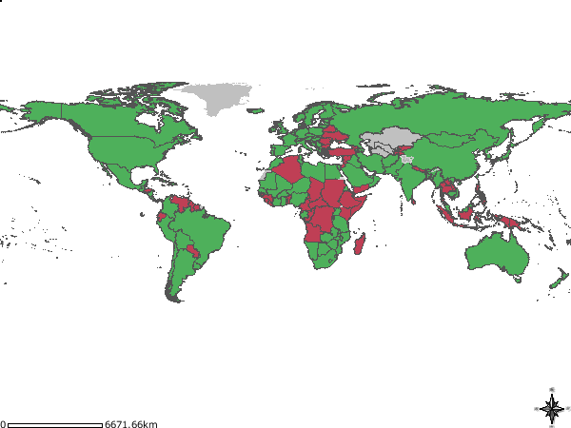
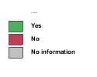
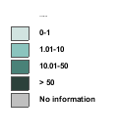
Global Mental Health Resources
Community care in mental health (MH), By Country, Total, 2005 Source: Mental Health Atlas 2005
Psychiatric nurses / 100,000 (MH), By Country, Total, 2005 Source: Mental Health Atlas 2005

Slide 6
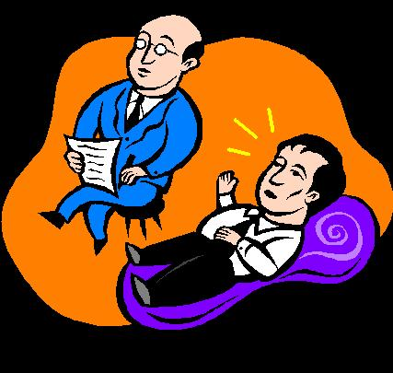
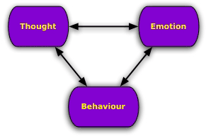
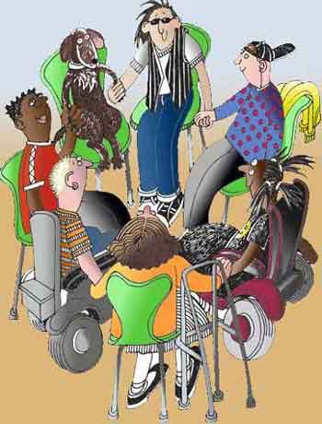
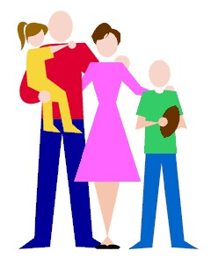
COMMON THERAPIES
In Australia, Sweden and Canada:
Anti-depressant medications
Psychotherapy,
Cognitive behavioural therapy,
Interpersonal therapy, and
Family therapy

Slide 7
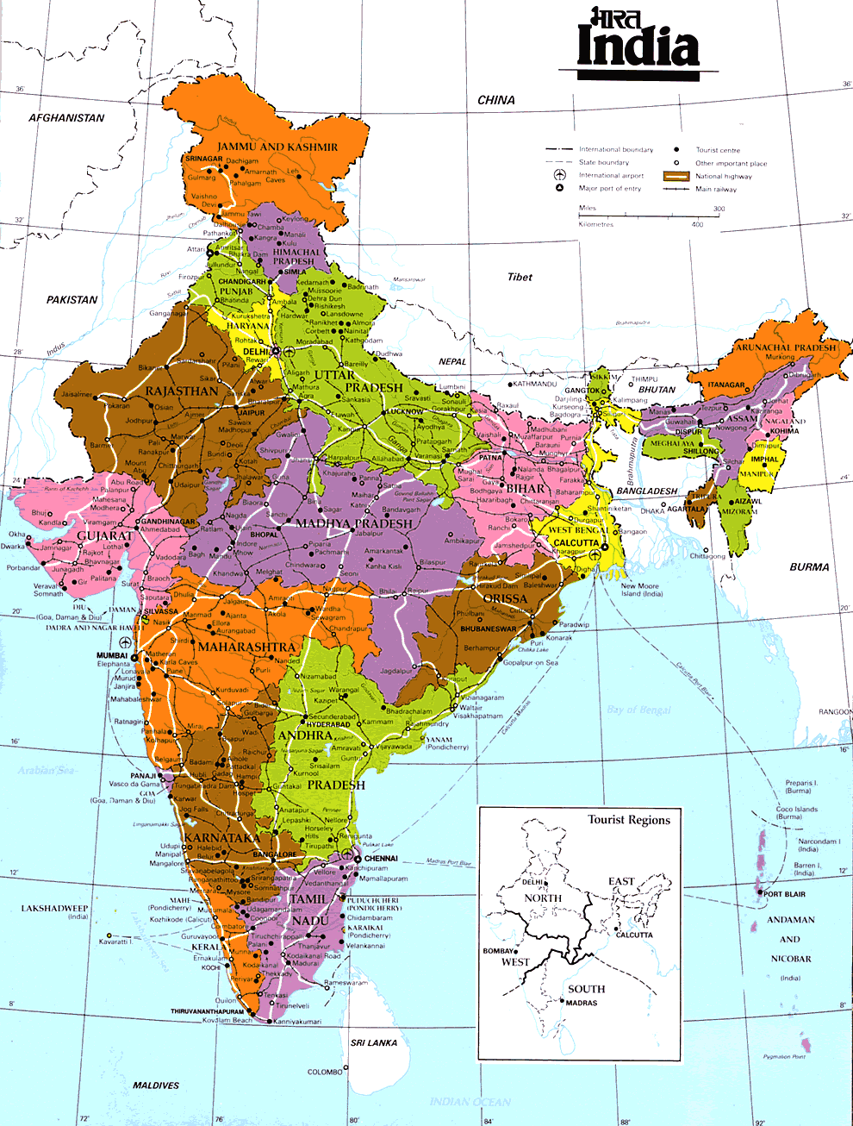
INDIA
Population of 1,103,371,000
In 2001, for every 100,000
people in India there were;
0.4 psychiatrists,
0.04 psychiatric nurses,
0.02 psychologists, and
2.5 psychiatric beds

Slide 8
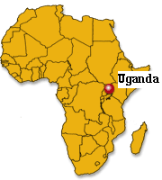
UGANDA
Population of 24,700,000
For every 100,000 persons there are said to be;
0.05 psychiatrists (12 psychiatrists in total), and
346 traditional healers

Slide 9
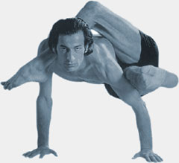
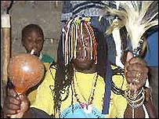
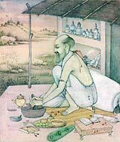
In Uganda & India:
Traditional Healing is the most common treatment modality:
Lack of access to western psychological treatment
Belief systems
Causes of depression
Methods of Treatment
Stigma
Economic reasons

Slide 10
What you didn’t know about Depression …
Causes
Mobile Phones & SMS?
Consumerism?
Success rates for medication are not what they seem
Standard ’talk’ therapies have a high relapse rate.
Causes
Childhood Trauma
Dysfunctional Relationships
Severe stress
Notes:
- Det finns hos unga vuxna ett samband mellan psykisk ohälsa och hög användning av mobiltelefon och dator, har vi sett. Men vi vet ännu inte vad det är i den nya tekniken som orsakar symptomen eller om de beror på något annat, säger Sara Thomée, psykolog vid sektionen för Arbets- och miljömedicin vid Sahlgrenska universitetssjukhuset i Göteborg.
The truth is that antidepressants work for less than 50% of depressed people, and are about as effective as sugar pills. The FDA only recommends taking them for short periods.
Standard forms of psychotherapy for depression, cognitive behavioral therapy, has a relapse rate of up to 80%, according to University of Washington researchers.
Childhood trauma is now recognized as the primary cause of clinical depression. This can include everything from outright abuse to criticism, lack of attention, unclear boundaries, divorce, conflict within the household, neighbourhood or even violence on TV.
The “accidents” which lead to depression are almost always dysfunctional relationships. As adults we tend to seek out and recreate the most difficult relationship patterns from childhood, and so the damage is perpetuated, reinforcing our vulnerability to depression.
The good news is that certain kinds of supportive and trust-worthy relationships can actually undo the damage of poor relationships. The brain is capable of growing new cells in a process called neurogenesis. But to do so the brain needs a safe and emotionally healthy environment, free from the trauma of criticism, uncertainty, abandonment and abuse.
Severe stress early in life has been associated with smaller hippocampal volume and persistent change in the hypothalamic-adrenal axis (can’t help thinking about trees and the different sizes of the rings depending on how good the year was). In this paper they compared the measured hippocampus volume in depressed women with and without a history of child abuse. The findings showed that a smaller hippocampal volume was observed exclusively in those that had been subjected to a severe or prolonged history of child abuse.

Slide 11
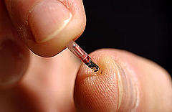
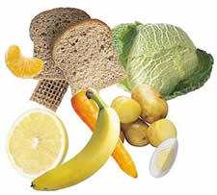
What’s the Alternative?
Animal therapy
VNS Therapy
Nutritional Therapies
Self Help?
Self Asessment Online http://www.mayoclinic.com/health/depression/MH00103_D
Mood Gym http://moodgym.anu.edu.au/
Notes:
One research paper shows improvement of mildly to moderately depressed people when treated with animal facilitated therapy in this case with dolphins in accordance with the biophilia hypothesis “The biophilia hypothesis suggests that there is an instinctive bond between human beings and other living systems”. Of course many people believe that close interactions with nature and animals may be very positive for anyone (maybe not with cockroaches).
The latest information about animal facilitated theraphy in Sweden is that in Markaryd there is a dog with a psychiatric legitimation the only one in Sweden, and it has become a huge success, maybe we will get a recepie for animal facilited theeraphy in the future.
In July 2005 Implants for VNS theraphy (Vagus Nerve Stimulation) was approved by FDA for treatment of TRD (Treatment Resistant Depression). Pilot data suggests VNS has antidepressive effects, but little is known about the long term effects of this treatment and nothing is written about the risk of over stimulation or misuse of the device.
According to the company behind the implant (Cyberonics) more than 40,000 patients worldwide has been treated with VNS therapy until 1 of May 2006.
Nutritional therapy has received increasing attention as a potentially effective means of preventing and controlling depression. Studies show that patients with low levels of selenium had lesser symptoms of depression after being given supplement of selenium (Benton & Cook, 1991), and that Omega 3 (EPA) supplements also appear to improve states of depression (Stoll, Severus, Freeman, Rueter, Zbovan, Diamond, Cress & Marangell, 1999). Supplements of the vitamins B1, B2, B6, B12 and folic acid have also been shown to decrease rates depression as well as increase cognitive functions (Mischoulon, Burger, & Spillmann, 2000). Other studies have shown the importance of an adequate level of tryptophane in our daily meals, a lack thereof leading to acute depression in the studied patients (DesMaisons & Pert, 1999).

Slide 12
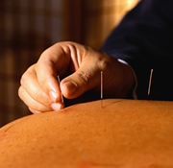
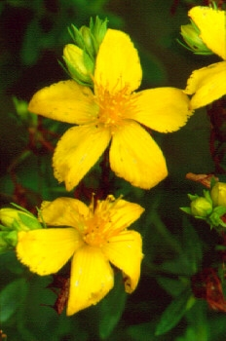
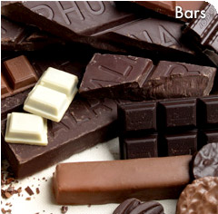
EVIDENCE-BASE OF ALTERNATIVE TREATMENTS FOR DEPRESSION in Australia
GOOD EVIDENCE
St John’s Wort (herb)
Physical exercise
Self-help books involving Cognitive
Behaviour Therapy
Light therapy (for winter or seasonal
depression)
SOME EVIDENCE
Acupuncture
Light therapy (for non-seasonal
depression)
Massage therapy
Negative air ionisation (for winter
depression)
Relaxation therapy
S-Adenosylmethionine
Folate
Yoga breathing exercises
POOR EVIDENCE
Ginseng
Lemon balm
Painkillers
Vervain
Colour therapy
Prayer
Chocolate

Slide 13
What’s the Answer?
Attitudes and Beliefs
Open-minded treatment
Collaborative approach globally
Notes:
Much of the difficulty in applying techniques used in the developed world to the developing countries lies in the attitudes and beliefs surrounding depression and mental illness in general. Most simply, this is indicated in the lack of an accurate translation of depression as an illness in many of the languages found in developing nations (Ovuga et al., 2005; Okello, 2006; Patel et al, 2004.)
As global migration continues to grow and multicultural practices become the norm in many places, we are exposed to other cultures and different thinking patterns that gives us a broader perspective of the disease in the developed world.
The literature reviewed indicates that there is not one way to treat every person with depression. The step towards a more holistic treatment regime in both the developed and developing countries discussed shows potential for a breakthrough in the treatment of depression, as it provides more options for patients to be treated on an individual level. Individual treatment of patients has been proven effective in most areas of health care, mental health care being no exception. Treating each patient with the method that most suits them individually, whether it be through pharmacological means or by ‘balancing the humors’, would be much more effective than treating them according to the countries’ ‘norms’. This may be the key to future success in the minimization and management of the worldwide burden of depression, but requires an ‘open-minded’ approach from health professionals across the globe.
Furthermore, it appears that a collaborative approach between both developed and developing parties would be the best way to combat the ever-increasing burden of depression. Developing nations can benefit from the pharmacological and therapeutic experience of developing nations however are likely to require economic assistance in implementing these. Developed countries would do well to consider the efficacy of simple, community based support therapies that encourage re-entry into familiar social contexts, and which can be more viable in terms of resources.
Conclusion
Depression continues to pose an enormous challenge to health resources and legislation in both developing and developed countries. Therapeutic patterns differ significantly between developed nations and their developing neighbors. The ‘first’ world countries rely heavily on relatively expensive, modern pharmacological treatments supported by individual ‘talk’ therapy. On the contrary, the ‘third’ world nations seem to prefer traditional holistic treatments supported by community based social support.
Though detailed analysis of the reasons for these differences is beyond the scope of this paper, the available data suggests that economic and political factors play a significant role.
There is currently an increase in exchange of ideas and therapeutic approaches between the developed and developing countries, something that we believe can only improve the mental health of people across the world.

Slide 14
Utopia or Dystopia
Is the choice between
homo roboticus vs. homo holisticus ???
?????

